Slide 1

Welcome to Early Years Foundation Stage
Curriculum Presentation For Parents
September 2026

Slide 2
At our school, with Jesus in our hearts, we have:
-The passion to learn
-The courage to fail
-The strength to love.
Notes:
NOTE: To change images on this slide, select a picture and delete it. Then click the Insert Picture icon in the placeholder to insert your own image.

Slide 3

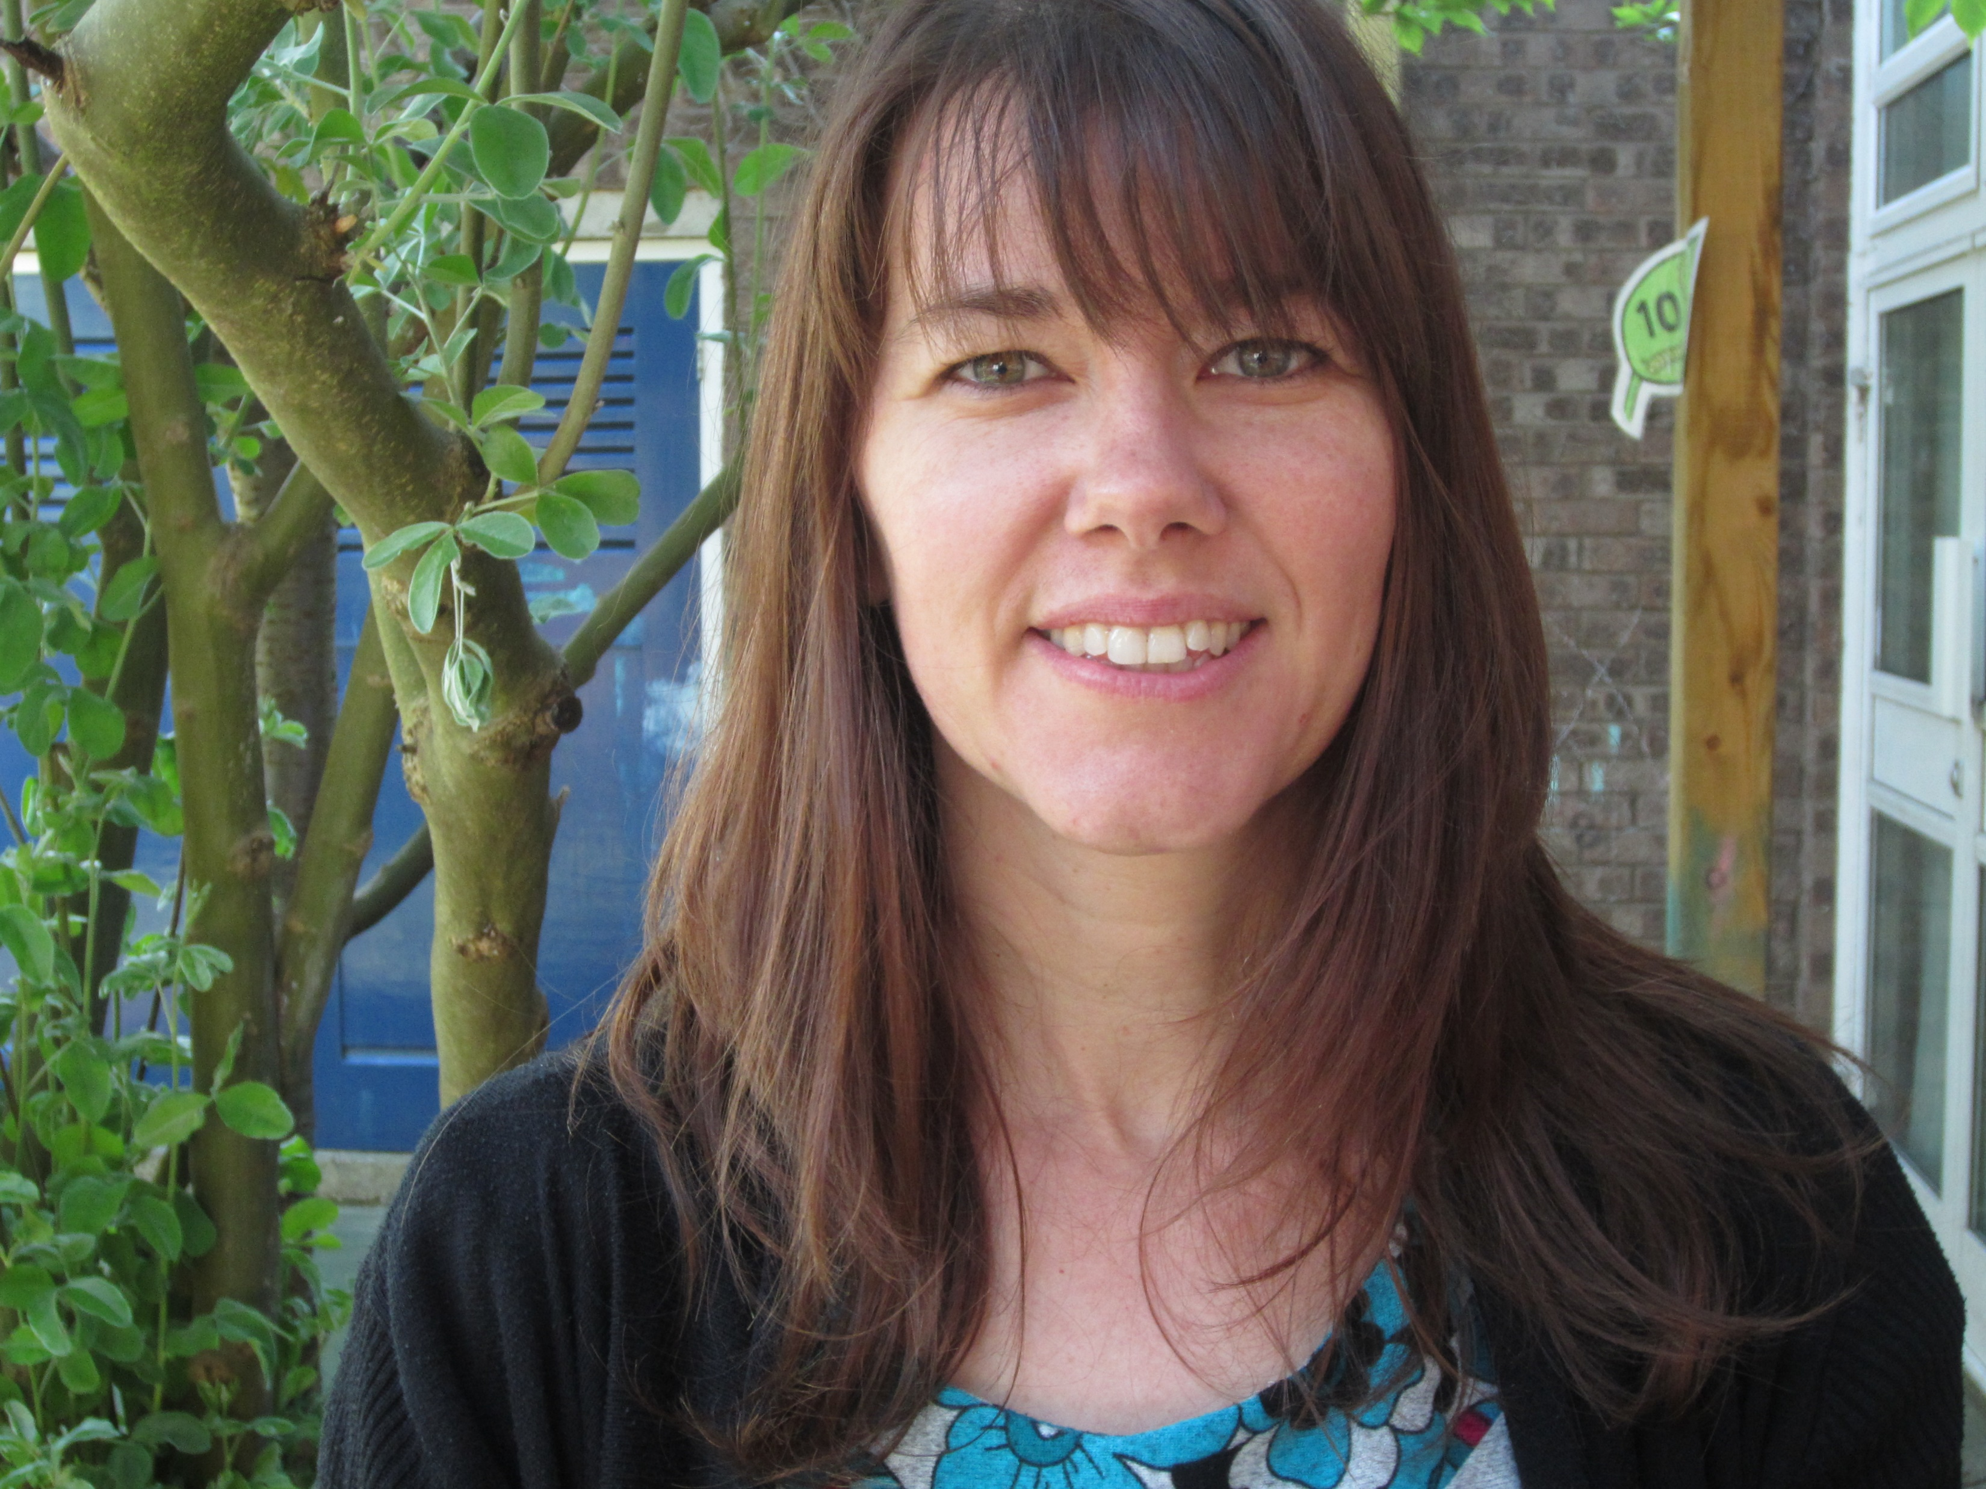
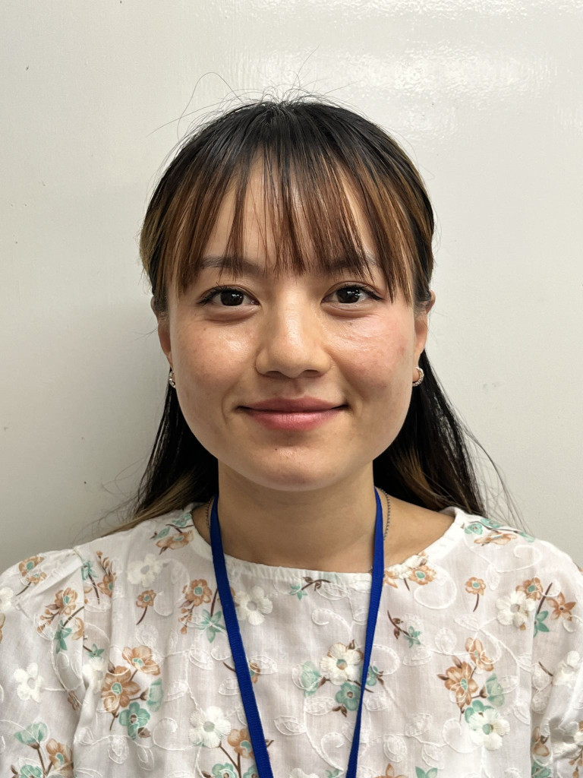
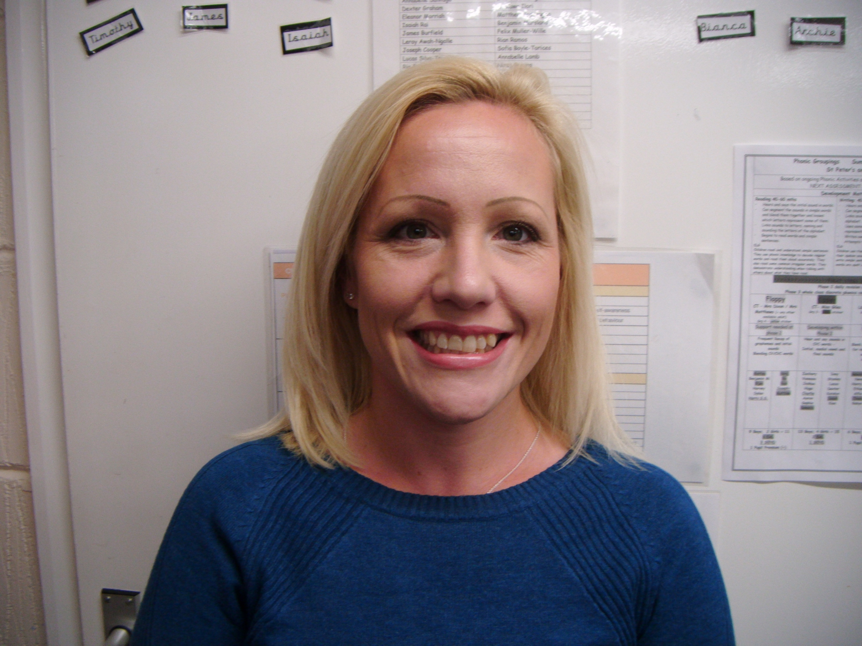
Shakespeare Class
Foundation Stage Teachers
-Mrs Dickinson
-Mrs Matthews
Early Years Support Assistants
-Mrs Francis, Ms Rai, Mrs Jarman, Mrs Cronin
Notes:
NOTE: To change images on this slide, select a picture and delete it. Then click the Insert Picture icon in the placeholder to insert your own image.

Slide 4

Our School Day
Drop off/Enter School building: 8.40 – 8.50am
Register closes: 9.10am
Lunchtime starts: 11.45am
Lunchtime finishes: 1pm
Pick Up: 3.20pm
It is important to ensure your child arrives on time every day.
Please let the office/ class teacher know going home arrangements if they are different than usual.
If children are not collected by 3.30pm they will be sent to after school club and you may be charged.
Notes:
NOTE: To change images on this slide, select a picture and delete it. Then click the Insert Picture icon in the placeholder to insert your own image.

Slide 5
Our Creative Curriculum
Using the Early Years Framework and guidance from Development Matters, we provide a rich and stimulating experience, following the children's interests.
We encourage ‘Child-Initiated Learning Through Play’ in our classroom, break out room (‘the Snug’) and in Yr R’s outside learning environment, which we call the Paddock.
We also visit the local area when taking the children on local walks - to the park, the Post Office, and later, further afield to Wisley. We organise visitors to school to support learning - for example, the Police and Air Ambulance.
Please let us know if you are happy to come in to talk to the children about your ‘helpful’ job!

Slide 6
Themes (flexible planning according to children’s interests)
Autumn Term
All About Me
Sparkles and Stars; Christmas
Spring Term
People Who Help Us
Heroes and Happily Ever After
Summer Term
Grow, Grow, Grow!
Animal Magic + Transition
RE
We follow the ‘Lighting the Path’ scheme of work from the Catholic diocese of Portsmouth, covering themes such as Creation and covenant, Desert to Garden, and to the ends of Earth
You can keep up-do-date with your child’s learning by accessing our curriculum page on the school website.
https://www.st-bernadettes.hants.sch.uk/year-r-shakespeare-class/

Slide 7
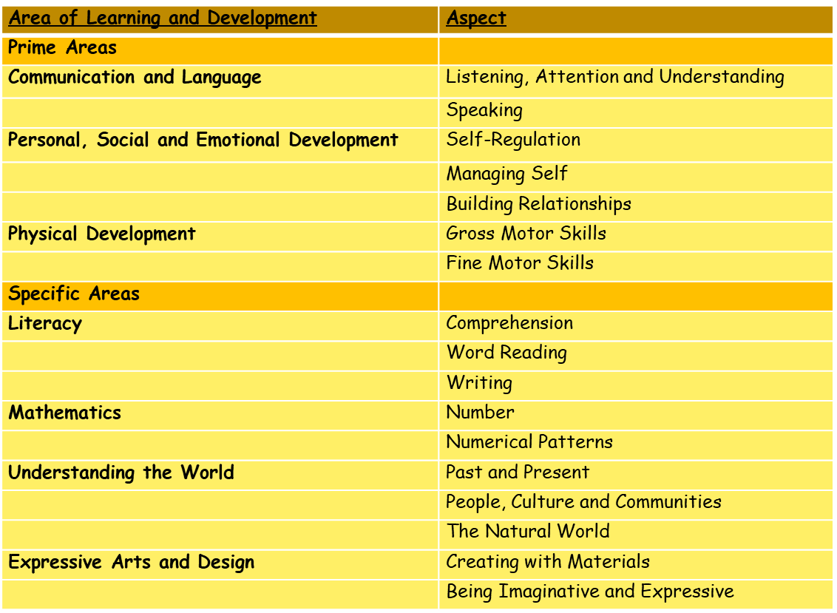
17 Early Learning Goals

Slide 8
Our School Rules
Be safe
Be respectful
Be ready to learn
Notes:
NOTE: To change images on this slide, select a picture and delete it. Then click the Insert Picture icon in the placeholder to insert your own image.

Slide 9
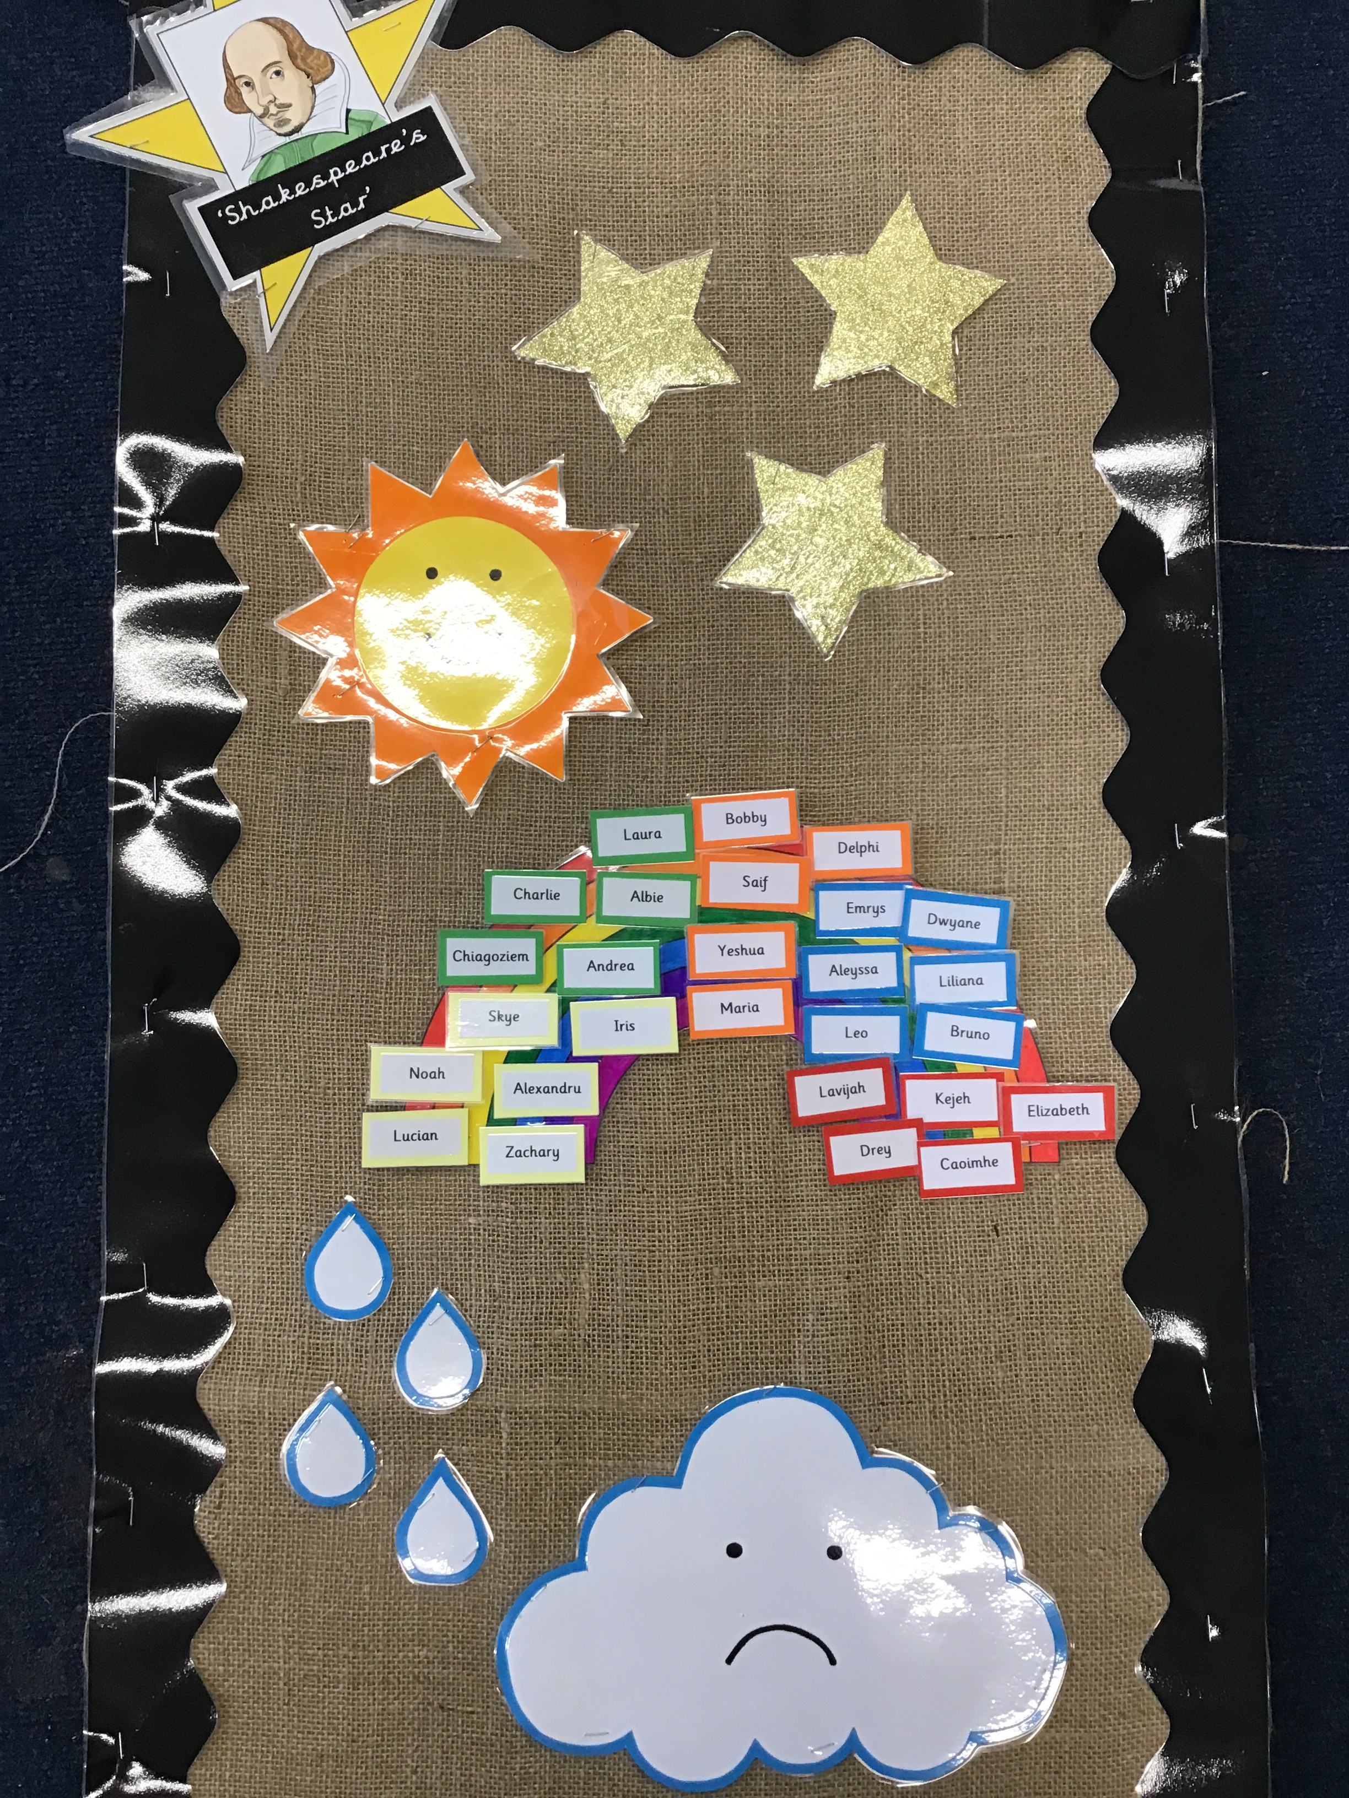

Slide 10
Timetable
Reading books and reading records should be in your child’s zippy wallet in school every day. Please ensure Home Learning books and library books are in on the appropriate days.
Mon: -Home Learning book returned to school
              -Shakespeare or Hathaway teddy / RE bag returned to school
-Reading book changed and new one sent home (to be brought in daily with reading record book)
Your child should be reading their reading book fluently (no or little sounding out to decode) with a 95% accuracy.
Wed: -Home Learning book sent home with new home learning in (every fortnight)
-Shakespeare or Hathaway teddy / RE bag sent home
-PE (no earrings or tights please. Children get changed at school.)
-Bring in Library book to be changed
Fri: Active Oracy for one colour group (see overview on Parents Whiteboard)

Slide 11
Assessment
Continuous assessment and observations made of all children to inform future planning
Statutory Baseline Assessment
https://www.gov.uk/government/publications/reception-baseline-assessment-information-for-parents
Learning Review Meetings (Oct & Feb)
Early Years Foundation Stage Profile
Reports (July)
Tapestry (online learning journey) and Big Books

Slide 12
Phonics
We follow the Little Wandle phonics programme.
Letter sounds (phonemes) using accurate articulation.
Phonemes are taught in specific sequence to allow early blending skills to be developed.
Be wary! ‘m, n, d, b’ – please listen to how Mrs Matthews says these phonemes!
Segmenting and blending phonemes and graphemes to read and write words.
To support at home: Please access the Little Wandle website, with support for parents, below:
https://www.littlewandlelettersandsounds.org.uk/resources/for-parents/
Or look on Tapestry, where we will post videos to ways to help support your child in reading and phonics!

Slide 13
Class information
Reading books and reading records should be in your child’s book bag every day. Please ensure Home Learning books and library books are in on the appropriate days.
Reading book and Reading Record – please write any comments in this book – we do value your comments.
Home Learning Book - variety of activities including RE, phonics and maths
Phonics sheets / key and tricky words / number practice cards
Laminated name to practise name writing (writing name by Christmas – lower case!)
Library book – changed weekly
‘Chance to take home ‘Shakespeare’ or ‘Hathaway’ bears.
Please use Tapestry to record any amazing moments of your child in their home environment – photos or videos.

Slide 14
How to help your child
Talk, talk, talk to your child – eye contact, no distractions, questioning, asking / giving opinions, getting them to follow simple instructions, asking about their day etc.
Your child is far more capable than they may let on! They are capable of getting dressed, using the toilet independently, using cutlery etc. Give them these opportunities!
You are your child’s greatest role model! Are you calm? Consistent? Are you demonstrating reading? Writing? Is your language appropriate?
Please do not complete your child’s home learning for them! A mark on the paper by them (with a note from you to explain what they have said or done) is far more meaningful to them and us, than a beautiful picture clearly drawn by Mummy.
Ongoing reading, writing and number practice at home will reinforce and celebrate your child’s learning and progress

Slide 15
Please check the Yr R parents whiteboard in the Paddock and Tapestry regularly, for notes and information about upcoming events.
Talk to your child about what dinner they are having every day, and please complete the menu list on Arbor (ideally for the whole week).
Regularly check your child’s online Tapestry learning journey and use the photos to talk to them about what they have been doing at school
Head bumps – you are informed by a slip in your child’s zippy wallet. Any serious concerns - we will call you.
Please do not allow your child or their siblings to play on or with the equipment in the Paddock before and after school – at times it is set up ready for the day’s learning.
Water only in sports bottles (avoid bottles with separate lids if possible).
Label, label, label!!

Slide 16
Uniform and Belongings
Your child is responsible for their own belongings. Each child has a peg to hang their PE kit, coat and book bag on.
The best way to support your child in doing this is to ensure that every item which is brought into school is clearly labelled with their name.
We no longer store lost property centrally and any unlabelled clothing is disposed of.
Please let the class teacher know if your child has mislaid something.
Infant uniform
White shirt (Polo shirt – summer only, no tie)
Trousers (shorts in the summer)
Grey skirt (dresses in the summer)
After the October half term, pupils will be expected to wear winter uniform (shirt and tie).
PE kit – red t-shirt, shorts, jogging bottoms, sweatshirt, trainers or plimsols

Slide 17

Issues Arising
Issues which arise in school will be dealt with in school by the staff.
Please do not approach other parents or children about incidents which have occurred in school, even if you know them well.
Social Media
Social media and group chats are not an appropriate forum to discuss issues concerning your children, another child or things which have happened in school: it can often compound a problem and, in our experience, it is never part of the solution.

Slide 18
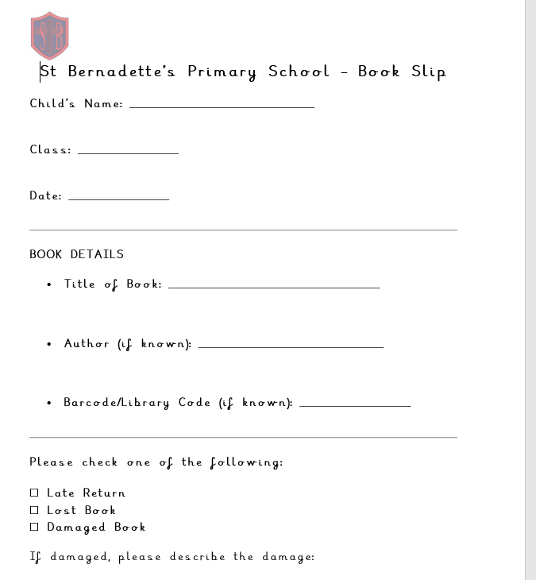
School Library
All children have the opportunity to visit our school library each week. Our library is stocked with a wide range of books suitable for all reading levels and interests. We are fortunate to work in partnership with the Schools Library Service, which provides us with a fresh stock of high-quality books each term. This ensures our collection remains engaging and encourages children to explore new genres and topics.
Year R library day is every Wednesday. Please make sure your child brings their library book in on this day, so they have the opportunity to borrow a new book.
Any books that are lost or damaged will need to be paid for. There will be a fine of £7 per book. If you are issued with a fine, you will receive an email from the school office. All fines can be paid via Arbor Shop.
We are always looking to enhance our library collection and are happy to accept book donations. If you would like to donate books, please ensure they are in good condition. We are looking for high-quality texts that will enrich our pupils’ reading experience, so we kindly ask that books linked to children's television shows (e.g., character-based or franchise books) are not included.
Notes:
NOTE: To change images on this slide, select a picture and delete it. Then click the Insert Picture icon in the placeholder to insert your own image.

Slide 19

Every Lesson Counts
Rules about requesting absence have changed – please do not request holidays in term-time. They will not be authorised unless deemed to be in exceptional circumstances.
If your child is ill, please let us know on the first day of absence by phone or email to school office.
If your child is ill, please do not send them to school. If they have been sick, they need to remain at home for at least 48 hours as sickness viruses are extremely contagious.

Slide 20

Oracy – Helping every child find their voice
At St Bernadette’s, we are committed to developing the whole child, not only academically, but also socially and emotionally. As part of this, we are excited to share with you our focus on oracy, which is the ability to speak and listen effectively.
Oracy is just as important as reading and writing, and it plays a vital role in helping children express themselves clearly, build confidence, and engage meaningfully with others. Oracy is developing the skills of talk as well as learning through talk.
To support our oracy development across the school, we are working with Voice 21, the UK’s leading oracy education charity. Through this partnership, we are embedding a consistent and purposeful approach to speaking and listening across all year groups.
Notes:
NOTE: To change images on this slide, select a picture and delete it. Then click the Insert Picture icon in the placeholder to insert your own image.

Slide 21

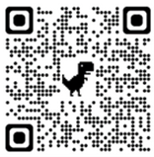
One of the ways we are supporting our young people and their families’, is by all of our children taking part in a programme called myHappymind. It is designed to support schools, families and early years settings who care about developing the mental wellbeing of children. The children have weekly inputs in class, designed to develop and support their emotional wellbeing.
To further embed this learning, myHappymind has developed a Parent App. These resources can be accessed online on your computer, or through an app on your phone.
To access these materials just go to https://myhappymind.org/parent-resources to create your free account.
You will need to enter your name, email, and authentication code.
Your authentication code is 116391

Slide 22
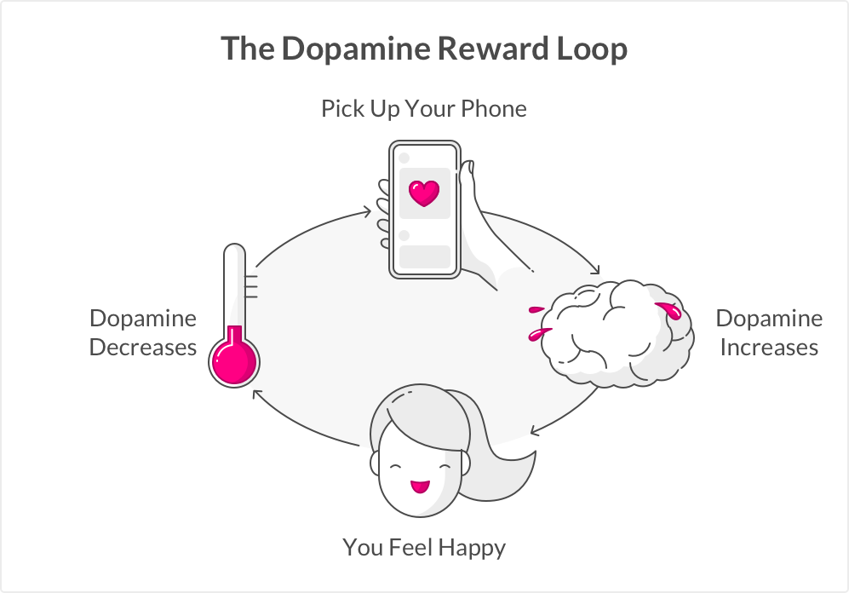
The impact of screen time on children
https://www.youtube.com/watch?v=WRal6an2NuQ

Slide 23

Thank you for taking the time to read through this PowerPoint. We hope that you find it useful and informative.
If you have any further questions or need further support, please send an email addressed to your child’s class teacher via the school office.
Many thanks,
Year R Team
Further information that follows this – How to support your child in the Prime and Specific Areas of Learning and Development in EYFS

Slide 24
Communication & Language
Listening, Attention and Understanding – in conversation with children and adults, for stories and lessons, asking and answering questions; following instructions’; positional language – on, under, beside, on top.
Speaking – expressing ideas appropriately; use of vocabulary and tenses; through play and talking in groups.
One colour group to have Active Oracy time each week – please see parents whiteboard for group and theme.
To support at home: Time to talk! Switch off TV, tablets etc and talk to your child about their day, likes, friends etc; share stories and ask questions about what they have read.

Slide 25
Personal, Social & Emotional Development
Self-Regulation - Managing feelings and behaviour in different situations, manners, show control and wait for what they want.
Managing Self – Demonstrating confidence, resilience, perseverance when challenged. Managing their own personal hygiene.
Building Relationships - Developing positive relationships with adults and peers. Taking turns, sharing.
To support at home: Praise your child when they make good choices; have a regular routine; encourage good manners; encourage independent toilet use inc. flushing and regularly washing hands; encourage your child to get dressed independently inc buttons and zips; expose your child to a variety of food.

Slide 26
Physical Development
Gross Motor Skills
P.E., Dough Disco, ‘Wake and Shake’, Cosmic Yoga
Large scale movements - apparatus, bikes, chalking etc.
Fine Motor Skills
Small scale movements for writing: threading beads, scissor skills, playdough, designing & making models with recycled materials.
Hold a pencil effectively (using the tripod grip).
To support at home: support home learning; encourage correct pencil grip; encourage your child to be active.

Slide 27
Literacy
Comprehension – retell stories, anticipate what will happen, use new vocabulary
Word Reading - Say a sound for each letter in the alphabet and at least 10 digraphs;
-Read words consistent with their phonic knowledge by sound-blending;
-Read aloud simple sentences and books that are consistent with their phonic knowledge, including some common exception words.
To support at home: Please read regularly and record in the reading record. Regularly practise phonic cards, tricky word cards etc with your child. Watch the reading videos which give more information on how to support your child when reading with them.
Your child should be reading their practice book fluently (no or little sounding out to decode) with a 95% accuracy.

Slide 28
Literacy
Writing – Make writing meaningful.
Spell words by hearing and identifying the sounds that make up the words (doesn’t have to be completely accurate!)
Please encourage children to write in lower case and NOT BLOCK CAPITALS.
Encourage children to use tripod grip.
To support at home: Encourage children to identify and write name (in lower case); give them lots of opportunities to mark-make e.g. write shopping lists, notes, letters to Nanny, birthday cards.

Slide 29
Mathematics
Number – Deep understanding of numbers to 10 – through practical games & problem solving
Stories, songs, games & imaginative play
Counting, sorting, matching – looking closely at each number, Numberblocks
Numerical Patterns – more than, less than, evens, odds, doubles etc
Patterns, shape, space & measure
To support at home: look for numbers and shapes in the environment; use practical equipment such as weighing scales when cooking; let them talk about money, look for colour, shape, number patterns.

Slide 30
Understanding the World
Foundation for later work in Science, D&T, Geography & ICT using skills of exploration, observation, problem solving, prediction, thinking, decision making, discussion, co-operation & asking questions
Expressive Arts and Design
Art, music, songs, dance, role play
Being imaginative.

